Slide 1
Unissued Stamps
&
Postal Forgeries of
Malaya
Presented by Barry Mudie

Slide 2
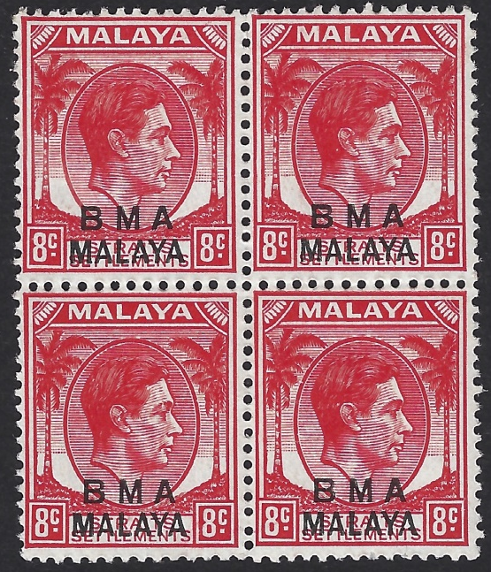
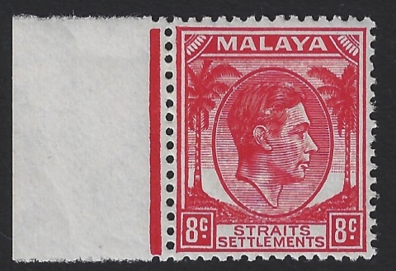
A study of stamps printed for various of the States, but never issued for sale or general release to the public
Straits Settlements 8c overprinted BMA Malaya
(British Military Administration).
Straits Settlements Unissued 8c scarlet
The 8c Scarlet, along with other values and State issues were on route to Malaya when it was occupied by the Japanese during WWII. Singapore surrendered on the 15th February 1942. The ship carrying the stamps was diverted to Australia. The stamps remained in secure storage for the duration of the war.
The un-overprinted 8c Scarlet came onto the market as a result of
“unofficial leakage”

Slide 3
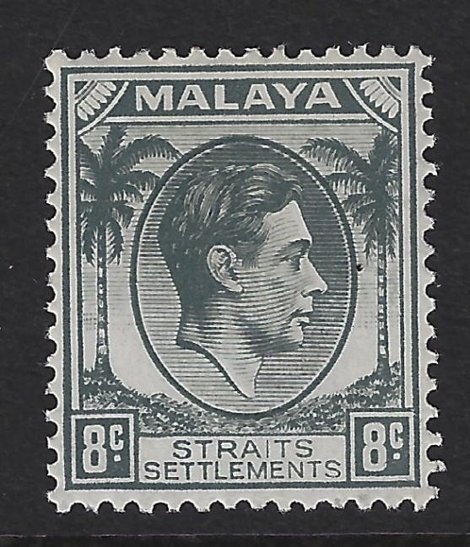
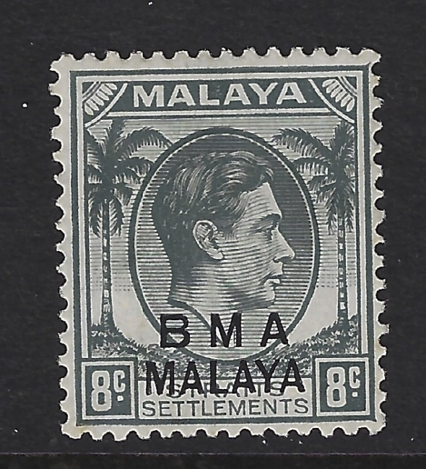
British Military Administration (BMA)
1945-48
Issued stamp of
Straits Settlements from the 1937-41 set
8c Grey
The same stamp
Overprinted BMA Malaya
Unissued
Just prior to the Japanese Occupation the 8c grey was being replaced with the 8c Scarlet to conform to UPU regulations.
The overprinted 8c grey was thus surplus to requirements.
This stamp is significantly scarcer than the 8c scarlet on the previous slide and came onto the market as a result of unofficial leakage.

Slide 4


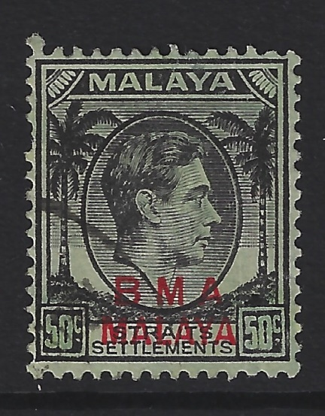
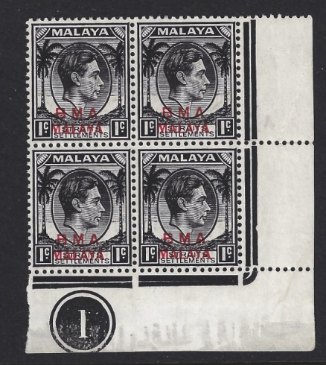
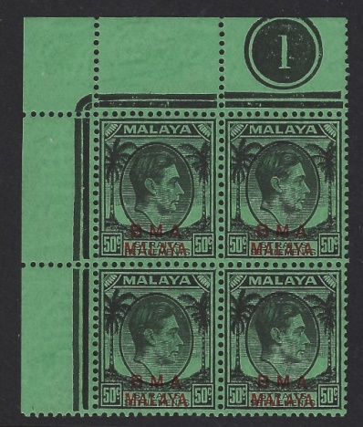
British Military Administration (BMA) 1945-48
50c black on green postal forgery
Altered value tablet on the 50c
Genuine 50c value tablet
The forgery was executed by dying the 1c green. Both value tablets were altered almost certainly by hand as the few known examples show clear evidence of this along with heavy retouching of the black around the value tablet.

Slide 5
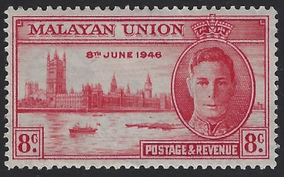
Malayan Postal Union
1946 Omnibus Victory Issue
Unissued 8c Carmine
In Malaya at the time of this Omnibus issue there was much political unrest and a “Malayan Union” was a long way from becoming a reality. It was decided therefore that this stamp issue should be destroyed. The only known 15c ultramarine is a cylinder block of 6 in the Royal Collection. All the stamps were taken to the municipal incinerator at Kuala Lumpur and destroyed but not before an employee managed to rake out about 400 8c values. Off those that survive many are fire damaged. This example is however perfect unmounted mint.
An iconic stamp from the reign of King George VI

Slide 6
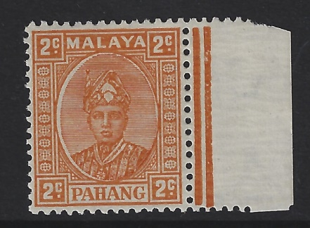
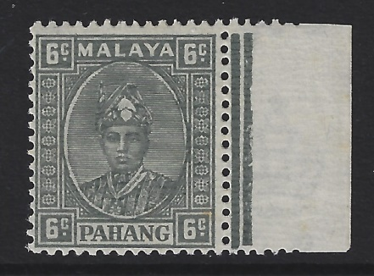
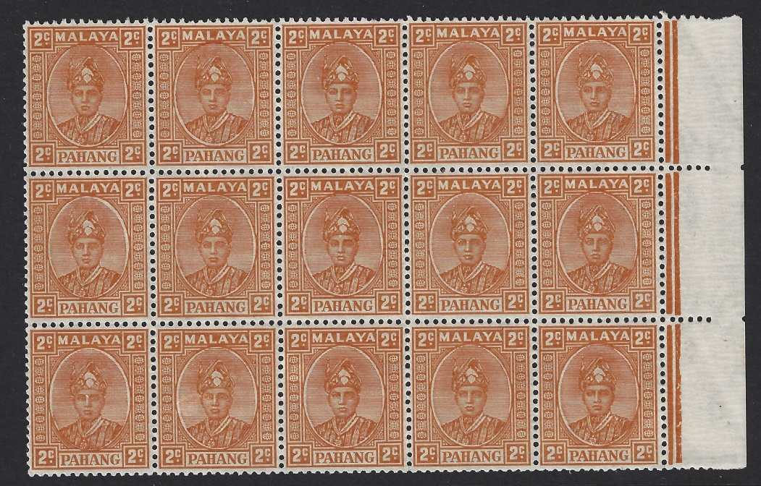
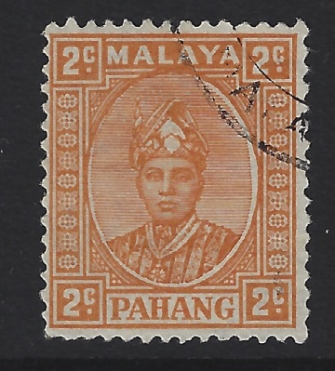
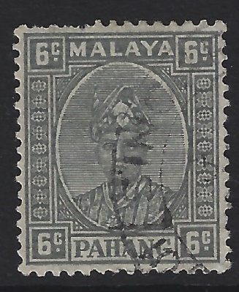
Federated Malay State of Pahang.
1935-1941 Sultan Sir Abu Bakar.
Unissued
2c Orange & 6c Grey.

Slide 7
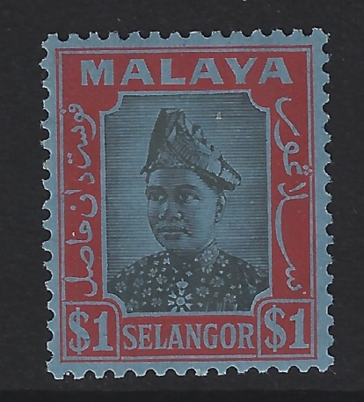
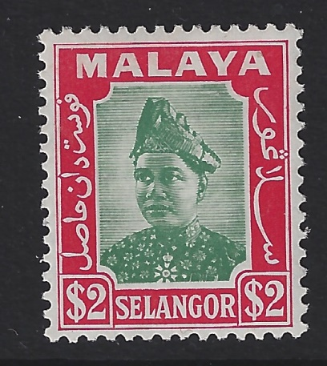
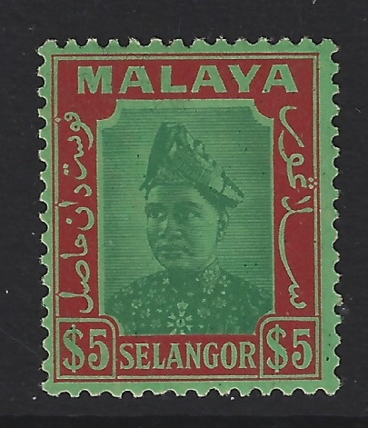
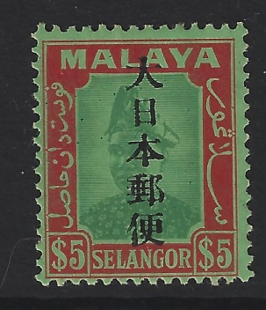
Federated Malay State of Selangor
1941 high values
Sultan Hisamuddin Alam Shah.
The issued $1 & $2 high value pair, with the Unissued $5 Green & Red on Emerald. There was no immediate need for the $5 value because there were still sufficient of the 1935 $5 in stock. So these were kept in storage.
During the Japanese Occupation they issued the $5 with overprint.

Slide 8
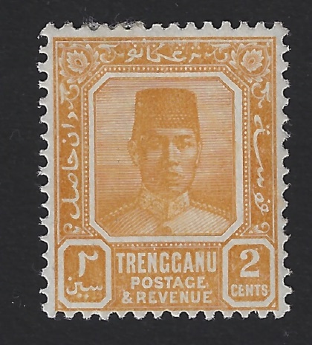
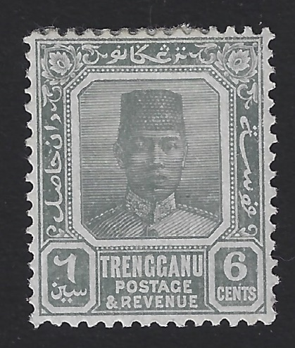
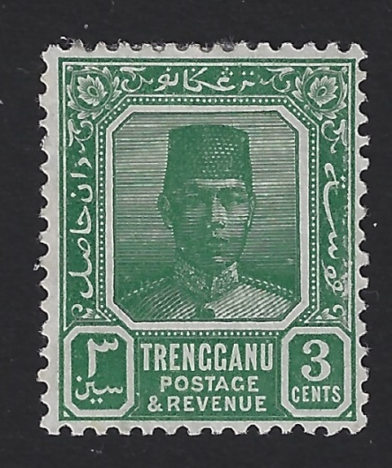
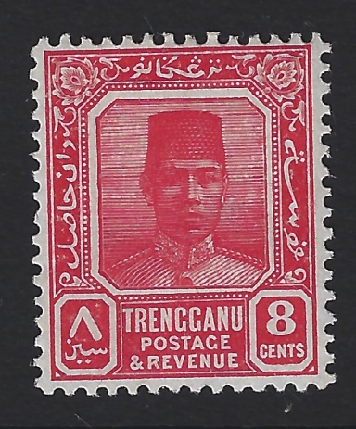
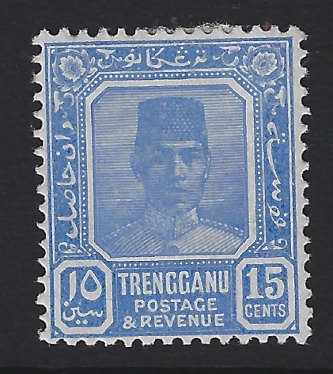
UnFederated Malay State of Trengganu
1921-1941
Sultan Suleiman
Unissued set of 5 values
2c Yellow-Orange
6c Slate Grey
3c Blue-Green
Despatched to Malaya in late 1941 but did not arrive due to the Occupation. These are some of the rarest unissued stamps of
Malaya. The 3c blue-green especially so.
8c Rose
15c Ultramarine

Slide 9
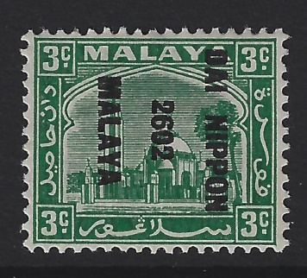
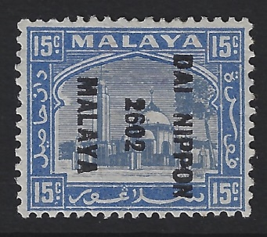
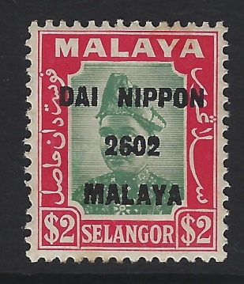
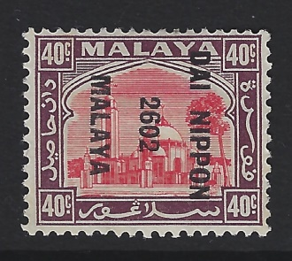
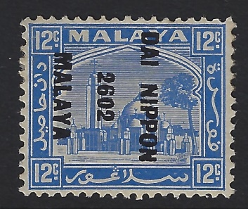
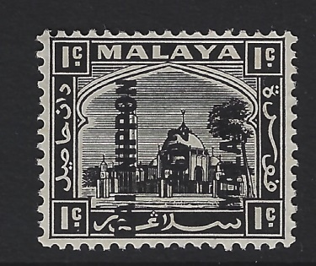
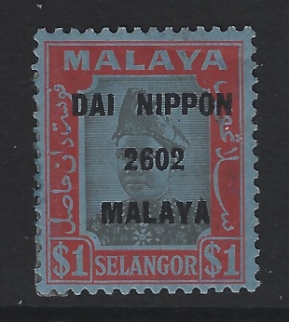
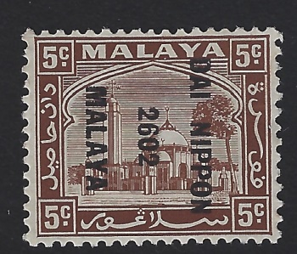
Japanese Occupation of Malaya
Stamps of Selangor
Set of 5 issued stamps, above.
3 of the 6 overprinted but unissued values below. The missing values being 10c, 30c & $5
These almost certainly came onto the market after the surrender of the Japanese in August 1945

Slide 10
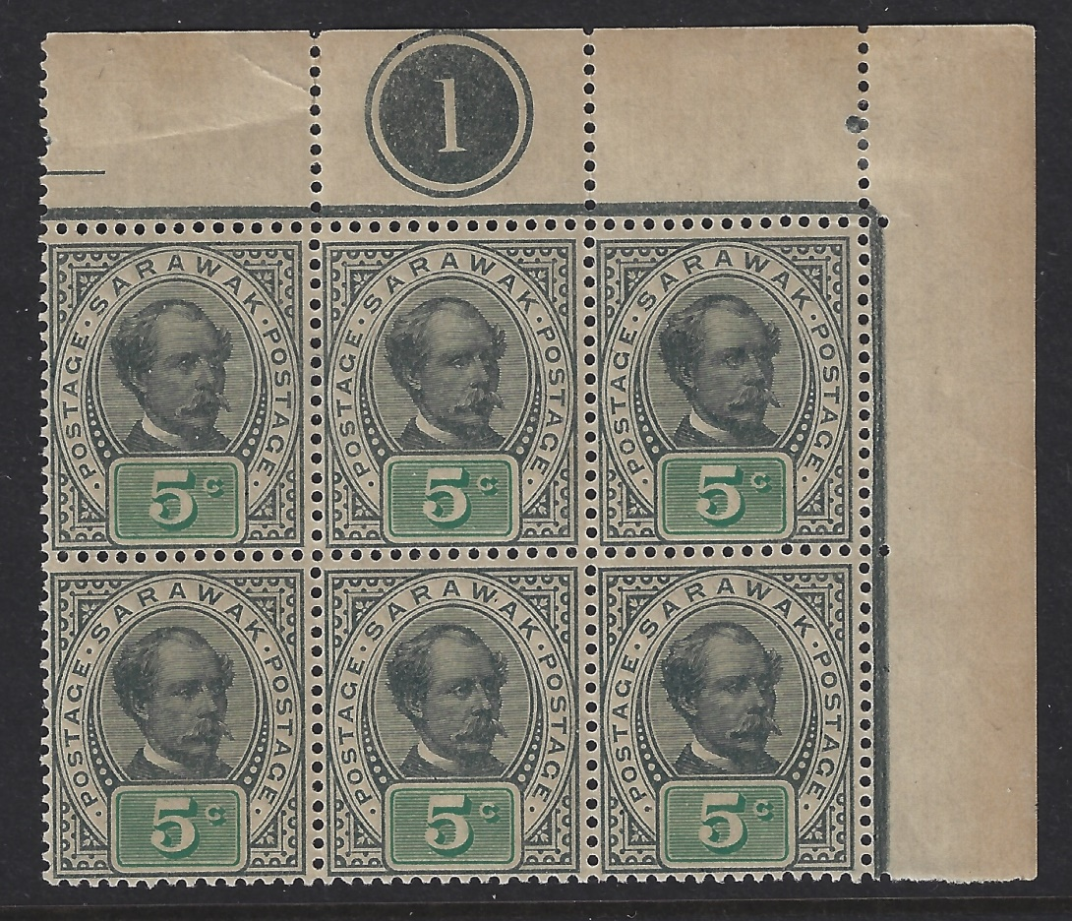
Sarawak
1899-1908
Sir Charles Brooke
Unissued 5c Olive-Grey & Green
This value was ordered to cover the 5c registration fee. Before issue however the fee was increased thus making the stamp redundant. The consignment was returned to the UK and at some point a few sheets were sold to a London dealer.

Slide 11
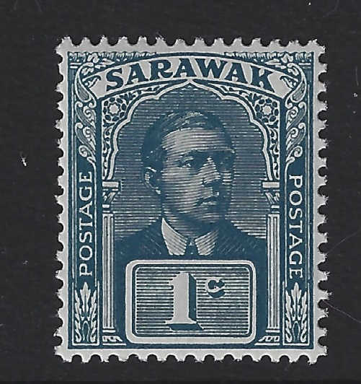
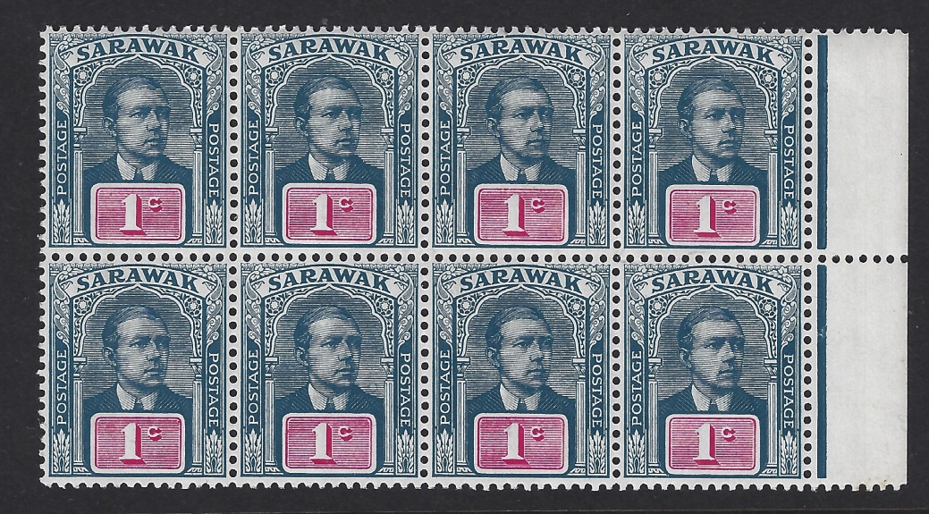
Sarawak 1918
Sir Charles Vyner Brooke
Unissued 1c Slate Blue & Slate
error of colour
& issued shade block of 8 Slate Blue & Carmine
In early 1918 a repeat order was place with DLR for the 1c value. Around the same time an order was placed for 1c value postcards in blue. By some error the colours were transposed with the stamp being printed in slate blue & blue. The stamps were despatched to Sarawak but the ship carrying them was involved in enemy action and the greater part of the consignment was lost. Some 7500 stamps did reach Sarawak where the error was discovered. None were ever issued to the public. Just a few sheets were sold to a London dealer as “Unissued stamps”.
The 1c postcard in blue & carmine was issued.

Slide 12
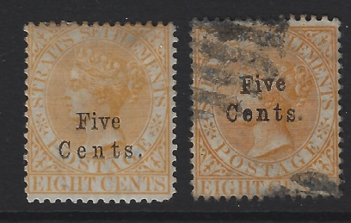
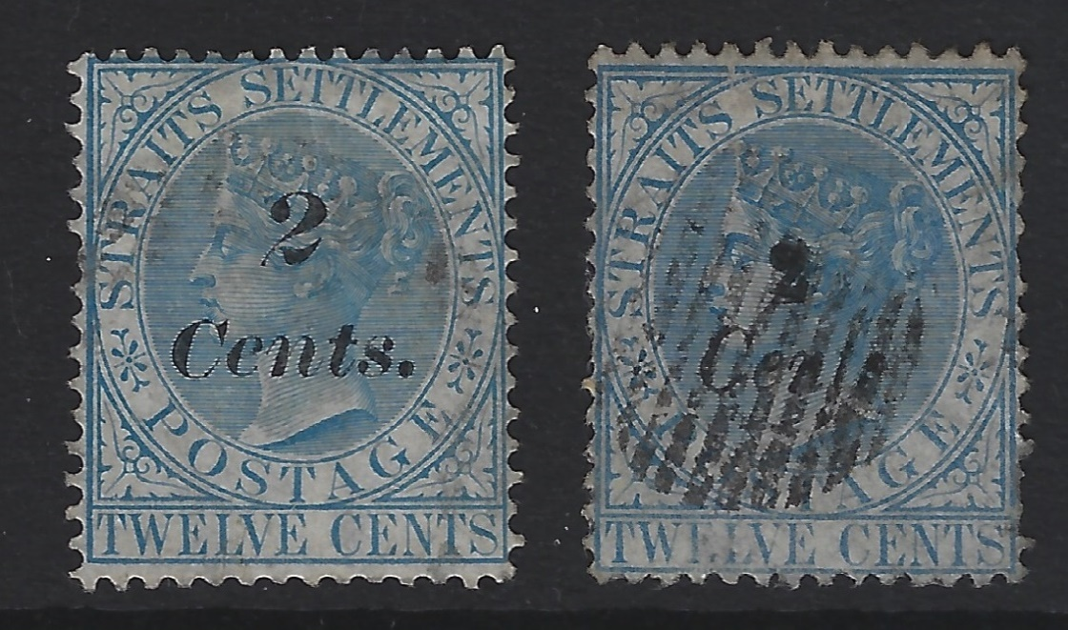
Straits Settlements Forgeries
Five Cents overprinted on 8c orange.
Wmk Crown CC SG20
Cat £190 used.
Issued 1879.
The forgery is on SG52
Wmk Crown CA Cat £1!
Issued 1882.
2 Cents on 12c blue.
Wmk Crown CC SG62
Cat £170 used.
Issued June 1883.
The forgery is a crude attempt when compared with the genuine.

Slide 13
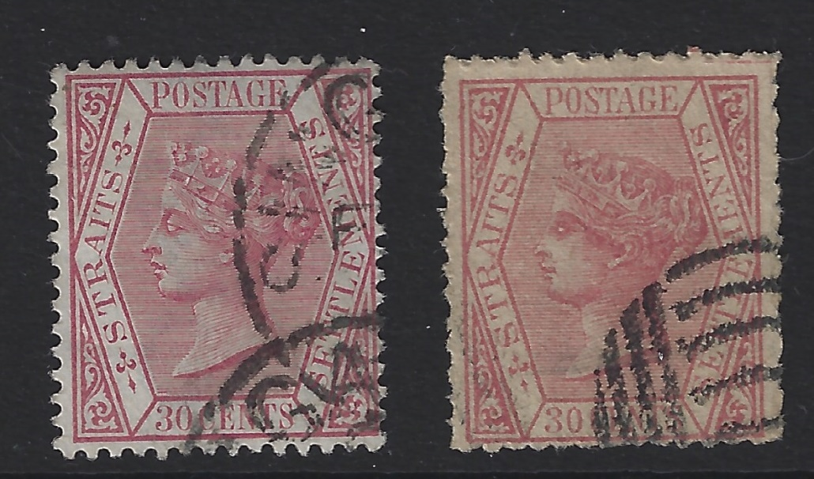
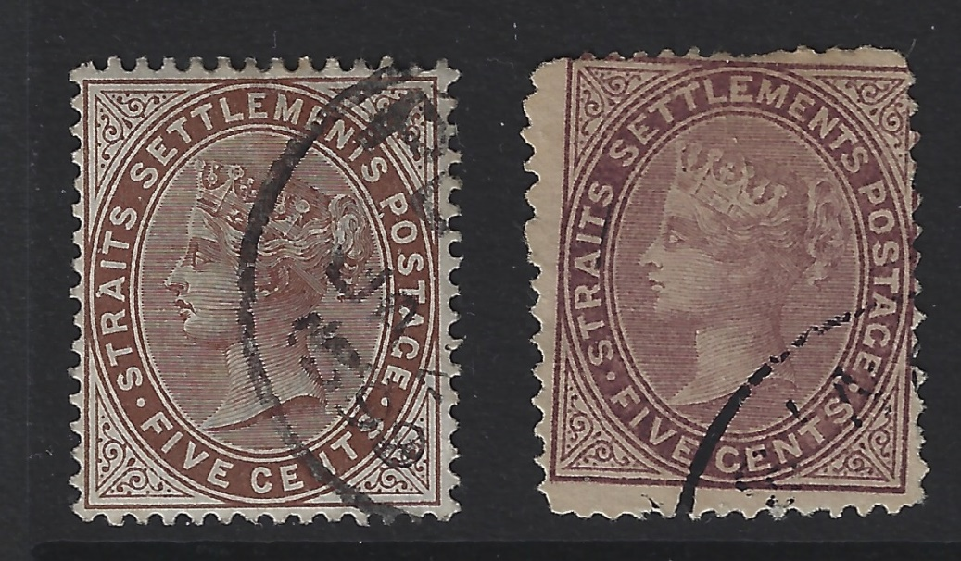
Straits Settlements Forgeries
1883 30c Claret
Wmk Crown CA
SG69
The forgery is on rough unwatermarked paper.
Poor perfs with a killer postmark of a type not used in Malaya.
1894 5c brown
Wmk Crown CA
SG99
The forgery is on rough unwatermarked paper.
Poor perfs &
Miss-aligned.

Slide 14
Thank you

